Slide 1
Requirements Modeling(2)
Ref:Chapt 9,10,11
Analysis Modeling

Slide 2
Analysis Modeling:Where to Begin?
A statement of scope can be acquired from:
  the system (FAST) working document
  A set of use-cases
The statement of scope must be “parsed” to extract data, function and behavioral domain information.

Slide 3
Statement of Scope
A relatively brief description of the system to be built
  Indicates data that are input and output and basic functionality
  Indicates conditional processing (at a high level)
  Implies certain constraints and limitations

Slide 4
Identifying Objects and Operations
Define “objects” by underlining all nouns in the written statement of scope
    producers / consumers of data
    places where data are stored
    “composite” data items
Define “operations” by double underlining all active verbs
    processes relevant to the application
    data transformations
Consider other “services” that will be required by the objects

Slide 5
Requirements Analysis Methods
Structured Analysis and Design Technique (SADT);
  Data
Object Oriented Analysis and Design Technique (OOAD);
  Object

Slide 6
Structured Analysis
Structured analysis is a model building activity:
  The products of analysis must be highly maintainable.
  The size of problems must be controlled.
  Graphics have to be used whenever possible.
  We have to differentiate between logical and physical.

Slide 7
SADT Analysis Model
Entity Relation Diagram (ERD);
Data Dictionary (DD);
Data Object Description (DOD);
Data Flow Diagram (DFD);
State Transition Diagram (STD);
Process Specification (PSPEC);
Control Specification (CSPEC);

Slide 8
Data Modeling
Entity Relationship (E-R) Diagram
Data Dictionary (DD)
Data Object Description (DOD);

Slide 9
Why Data Modeling?
Examine the data objects of processing independently.
Focus attention on the data domain.
Create a model of abstraction at the customer’s level
Indicate how data objects relate to one another

Slide 10
Creating Entity Relationship (E-R) Diagram

Slide 11
What is a Data Object?
Object
—something that is described by a set
of attributes (data items) and that will be
manipulated within the software (system).
each
instance
of an object (e.g., a book)
can be identified uniquely (e.g., ISBN #)
each plays a necessary role in the system
i.e., the system could not function without
access to instances of the object
each is described by attributes that are
themselves data items

Slide 12
Typical Objects
external entities (printer, user, sensor)
things
(e.g, reports, displays, signals)
occurrences or events (e.g., interrupt, alarm)
roles
(e.g., manager, engineer, salesperson)
organizational units
(e.g., division, team)
places
(e.g., manufacturing floor)
structures (e.g., employee record)

Slide 13
Data Objects and Attributes
A data object contains a set of attributes that act as an aspect, quality, characteristic, or descriptor of the object
object: automobile
attributes:
make
model
body type
price
options code

Slide 14
What is a Relationship?
relationship
—indicates “connectedness”;
a "fact" that must be "remembered"
by the system and cannot or is not computed
or derived mechanically
several instances of a relationship can exist
objects can be related in many different ways

Slide 15
ERD Notation
One common form:
(0, m)
object
relationship
object
1
(1, 1)
2
Another common form:
object
relationship
object
1
2
(0, m)
(1, 1)

Slide 16
Building an ERD
Level 1—model all the data objects (entities)
Level 2—model all the relationships among entities
Level 3—model all attributes of entities

Slide 17
The ERD: An Example
President
management
University
(1,1)
(1,1)
(1,1)
Course
(1,n)
(0,a)
belong-to
Department
(1,k)
(1,1)
(1,1)
Hold
Lecturer
(0,w)
engage
(1,1)
(0,i)
Select
Student
study
(1,b)

Slide 18
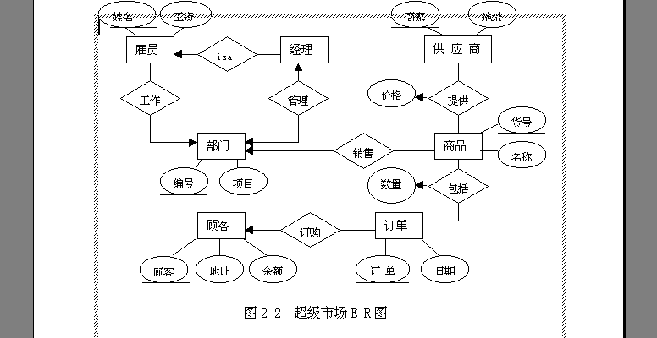

Slide 19
Creating Data Dictionary

Slide 20
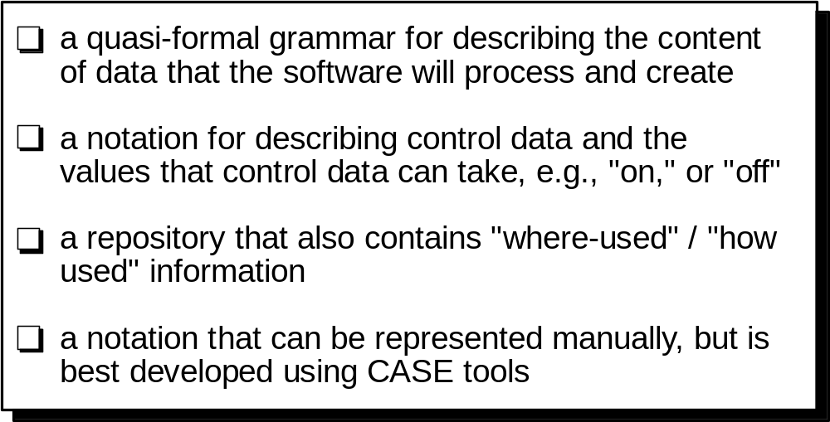
The Data Dictionary

Slide 21
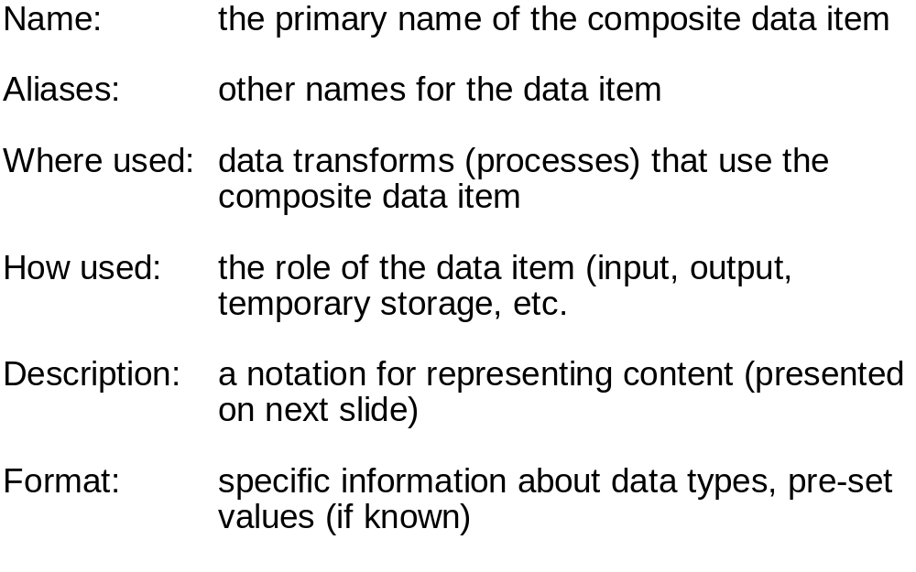
Building a Data Dictionary

Slide 22
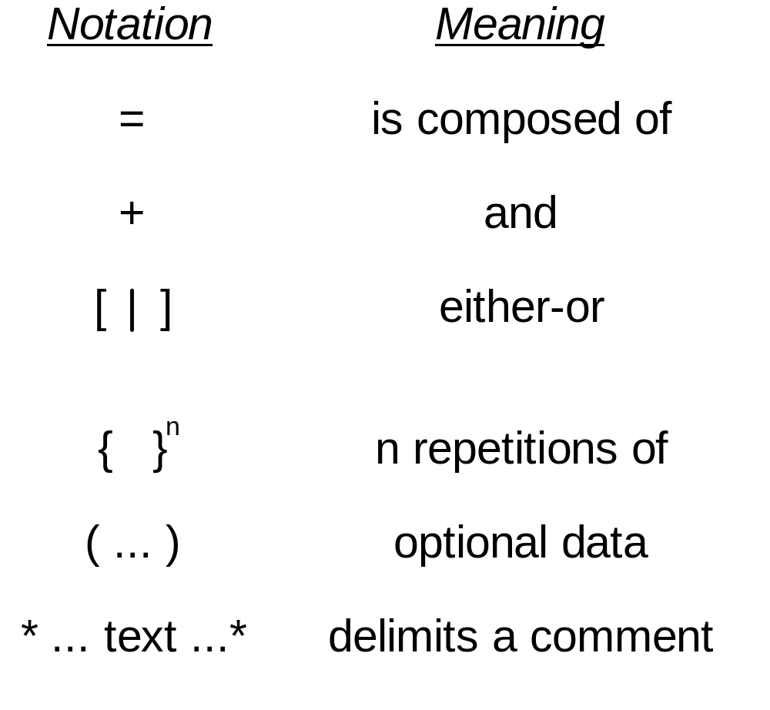
Data Dictionary Notation

Slide 23
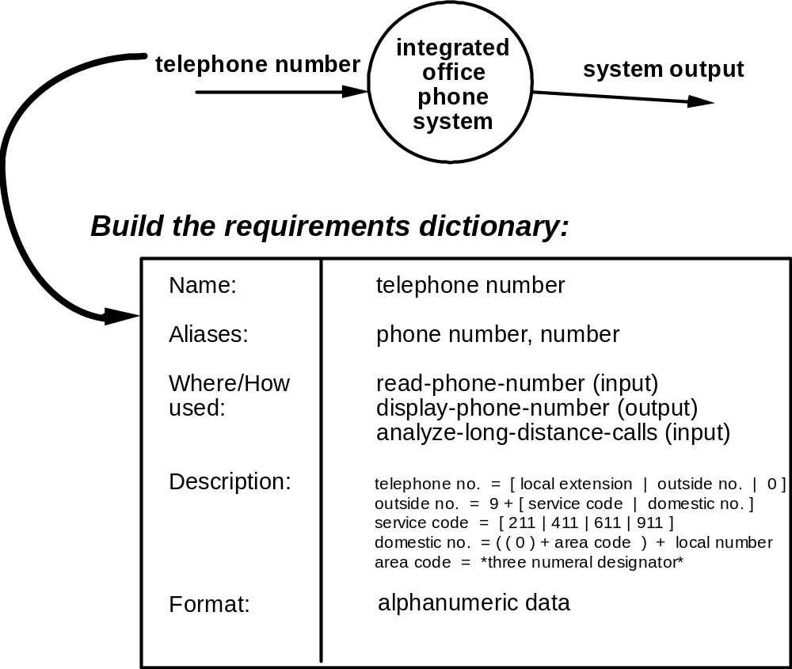
Data Dictionary Example

Slide 24
Function Modeling
Data Flow Diagram (DFD)

Slide 25
The Flow Model
Every computer-based system is an information transform ....
computer
based
system
input
output

Slide 26
Flow Modeling Notation
external entity
process
data flow
data store

Slide 27
External Entity
A producer or consumer of data
Examples: a person, a device, a sensor
Another example: computer-based
system
Data must always originate somewhere
and must always be sent to something

Slide 28
Process
A data transformer (changes input
to output)
Examples: compute taxes, determine area,
format report, display graph
Data must always be processed in some
way to achieve system function

Slide 29
Data Flow
Data flows through a system, beginning
as input and be transformed into output.
base
compute
triangle
area
area
height

Slide 30
Data Stores
Data is often stored for later use.
sensor #
sensor #, type,
location, age
look-up
sensor
data
report required
type,
location, age
sensor number
sensor data

Slide 31
Data Flow Diagramming:Guidelines
all icons must be labeled with meaningful names
the DFD evolves through a number of levels of detail
always begin with a context level diagram (also called level 0)
always show external entities at level 0
always label data flow arrows
do not represent procedural logic

Slide 32
Constructing a DFD—I
review ERD to isolate data objects and grammatical parse to determine “operations
determine external entities producers and consumers of data
create a level 0 DFD

Slide 33
Level 0 DFD Example
Display information
Control panel display
Control panel
User commands and data
Safe-Home software
Alarm type
alarm
sensors
Sensor status
Telephone number tones
Telephone line

Slide 34
Constructing a DFD—II
write a narrative describing the transform
parse to determine next level transforms
“balance” the flow to maintain data flow continuity
develop a level 1 DFD

Slide 35
The Data Flow Hierarchy
a
b
x
P
y
level 0
a
c
p2
f
p1
p4
b
d
5
p3
e
g
level 1

Slide 36
Level 1 DFD Example
Control panel
User commands and data
Configure system
Configuration data
Configuration request
Interact with user
Configuration information
Start/ stop
Activate/
deactivate system
Configuration data
password
Control panel display
Msg.
Display messages and status
Display information
Process password
Valid id msg.
alarm
Configuration data
Sensor information
Monitor sensors
Alarm type
sensors
Sensor status
telephone line
Telephone number tones

Slide 37
Level 2 DFD Example
Configuration information
Sensor information
Configure system
Alarm type
Configuration data
Sensor id type, location
Generate alarm signal
Alarm data
Assess against setup
Telephone number
Read sensors
Sensor id type
Display messages and status
Telephone number tones
Sensor status

Slide 38
Level 3 DFD Example
Sensor information
Sensor status
Configuration information
Generate display
Configuration data
Formated id, type, location
Read sensors
Format display
Sensor id, setting
Acquire response info
Alarm type
Sensor id type, location
Alarm condition code, sensor id, timing information
Alarm data
Generate alarm signal
Establish alarm conditions
List of number
Select phone number
Telephone number tones
Set up connection to phone net
Telephone number
Generate pulses to line
Tone ready telephone number

Slide 39
Flow Modeling Notes
each bubble is refined until it does just one thing
the expansion ratio decreases as the number of levels increase
most systems require between 3 and 7 levels for an adequate flow model
a single data flow item (arrow) may be expanded as levels increase (data dictionary provides information)

Slide 40
DFDs: A Look Ahead
analysis model
Maps into
design model

Slide 41
First-level Factoring Example
Monitor sensors executive
Alarm conditions controller
Sensor input controller
Alarm output controller

Slide 42
Second-level Factoring Example
Monitor sensors executive
Alarm conditions controller
Sensor input controller
Alarm output controller
Set up connection to phone net
Generate alarm signal
Format display
Generate display
Generate pulses to line

Slide 43
“First Iteration” Program Structure
Monitor sensors executive
Sensor input controller
Alarm conditions controller
Alarm output controller
Acquire response info
Establish alarm conditions
Select phone number
Generate alarm signal
Set up connection to phone net
Format display
Generate display
Generate pulses to line
Read sensors

Slide 44
“Refined” Program Structure
Monitor sensors executive
Acquire response info
Establish alarm conditions
Alarm output controller
Read sensors
Generate alarm signal
Set up connection to phone net
produce display
Generate pulses to line

Slide 45
Behavioral Modeling
State Transition Diagram (STD)
Control Specification (CSPEC)
Process Specification (PSPEC)

Slide 46
Behavioral Modeling
events
behavior
Outside
world
Application

Slide 47
The States of a System
state—a set of observable circum-stances that characterizes the behavior of a system at a given time
state transition—the movement from one state to another
event—an occurrence that causes the system to exhibit some predictable form of behavior
action—process that occurs as a consequence of making a transition

Slide 48
Creating State Transition Diagram (STD)

Slide 49
State Transition Diagram Notation
state
event causing transition
action that occurs
new state

Slide 50
The Steps of Modeling
make a list of the different states of a system (How does the system behave?)
indicate how the system makes a transition from one state to another (How does the system change state?)
  indicate event
  indicate action
draw a state transition diagram

Slide 51
An Example of State Transition Diagram
full and start
invoke manage-copying
reading
operator
commands
full
invoke read-op-input
copies done
invoke read-op-input
making copies
reloading paper
empty
invoke reload paper
jammed
invoke problem-diagnosis
not jammed
problem state
invoke read-op-input

Slide 52
The State Transition Diagram of SafeHome
Read user input
On / Off Switch
surveillance and control system
Out of tome
user interaction
Sensor events
surveillance and control system
Monitor system state
Sensor event behaviors
Sensor events
display info. and state
Sensor events
display info. and state
Sensor events
surveillance and control system
twinkle
display info. and state
Display user feedback
Display actions state
user interaction

Slide 53
Creating Control Specification (CSPEC)

Slide 54
The Control Model
the control flow diagram is "superimposed" on the DFD
and shows events that control the processes noted in
the DFD
control flows—events and control items—are noted by
dashed arrows
a vertical bar implies an input to or output from a control
spec (CSPEC) — a separate specification that
describes how control is handled
a dashed arrow entering a vertical bar is an input to the
CSPEC
a dashed arrow leaving a process implies a data
condition
a dashed arrow entering a process implies a control
input read directly by the process
control flows do not physically activate/deactivate the
processes—this is done via the CSPEC

Slide 55
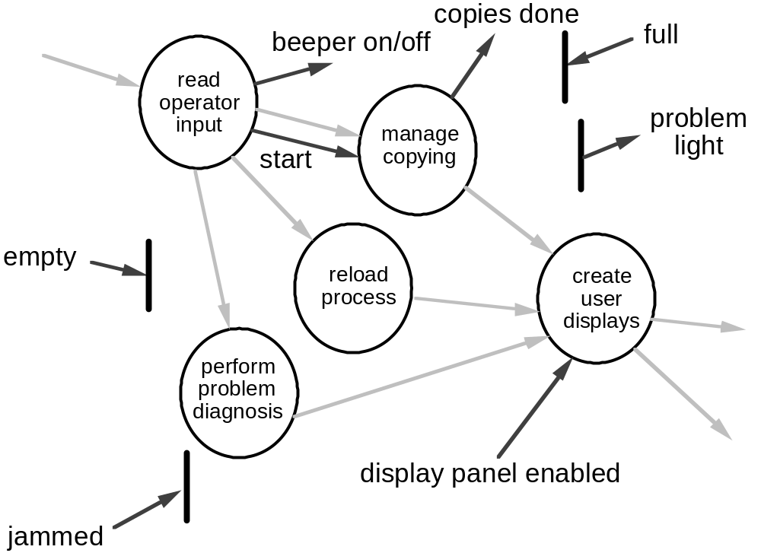
Control Flow Diagram

Slide 56
Control Specification (CSPEC)
The CSPEC can be:
state transition diagram
(sequential spec)
state transition table
combinatorial spec
decision tables
activation tables

Slide 57
Guidelines for Building a CSPEC
list all sensors that are "read" by the software
list all interrupt conditions
list all "switches" that are actuated by the operator
list all data conditions
recalling the noun-verb parse that was applied to the
software statement of scope, review all "control items"
as possible CSPEC inputs/outputs
describe the behavior of a system by identifying its
states; identify how each state is reach and defines
the transitions between states
focus on possible omissions ... a very common error in
specifying control, e.g., ask: "Is there any other way I
can get to this state or exit from it?"

Slide 58
Creating Process Specification (PSPEC)

Slide 59
Process Specification (PSPEC)
bubble
PSPEC
narrative
pseudocode (PDL)
equations
tables
diagrams and/or charts

Slide 60
A Design Note
PSPEC
one or more ”components"
in the software design

Slide 61
Creating Mini-Specs
Software
Specification

Slide 62
Process Model
Control Model
E-R
DIAGRAM
CONTROL
CONTEXT
DIAGRAM
RESPONSE TIME
SPECIFICATIONS
DATA
CONTROL
FLOW
FLOW
DIAGRAMS
DIAGRAMS
PROCESS
CONTROL
SPECIFICATIONS
SPECIFICATIONS
textual
DICTIONARY
decision tables,
activation tables
automata
Textual / graphic

Slide 63
Summary: Structured Analysis Modeling
Data Modeling
  Entity Relation Diagram (ERD);
  Data Dictionary (DD);
  Data Object Description (DOD);
Function Modeling
  Data Flow Diagram (DFD);
Behavior Modeling
  State Transition Diagram (STD);
  Process Specification (PSPEC);
  Control Specification (CSPEC);

